Slide 1
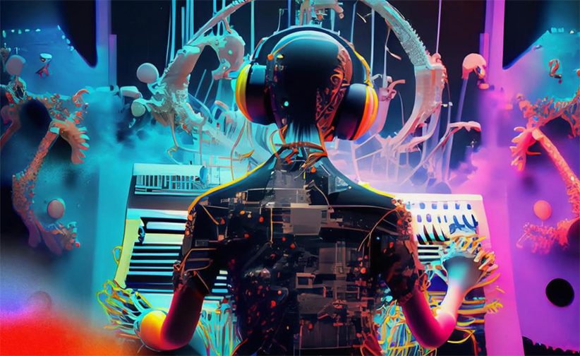
MUSE - Machine enhanced User Sound Experience
Shivam Arora, Aman Soni, Zubair Qazi, Sidharth
Image taken from https://ampedstudio.com/ai-in-music/
Department of CSE, University of Michigan, Ann Arbor

Slide 2
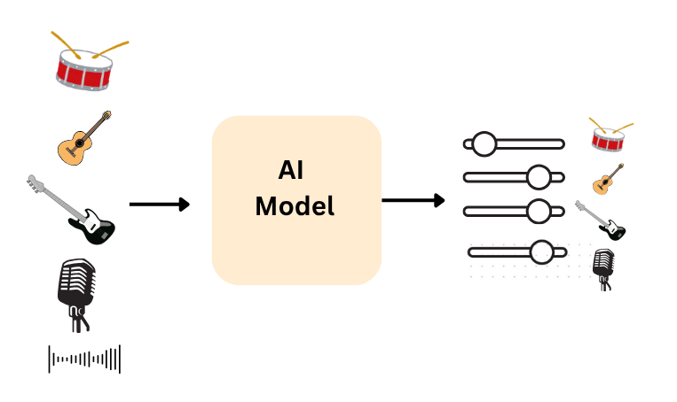
Recap
Design a personalized AI music mixing software to personalize music to users

Slide 3
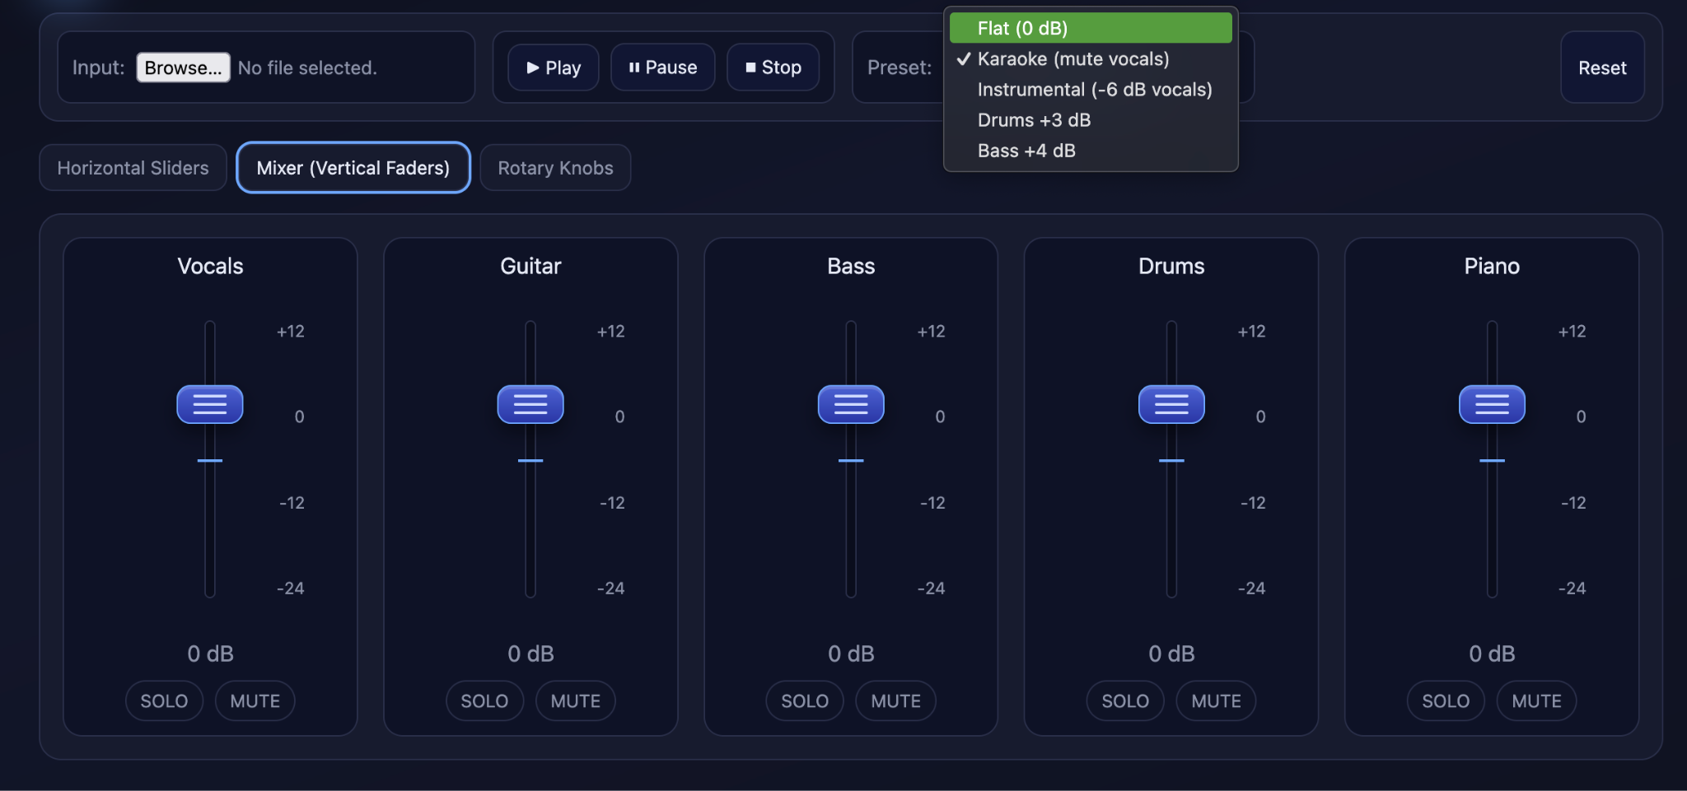
Design Choices
Wireframe 2 (Vertical Slider)

Slide 4
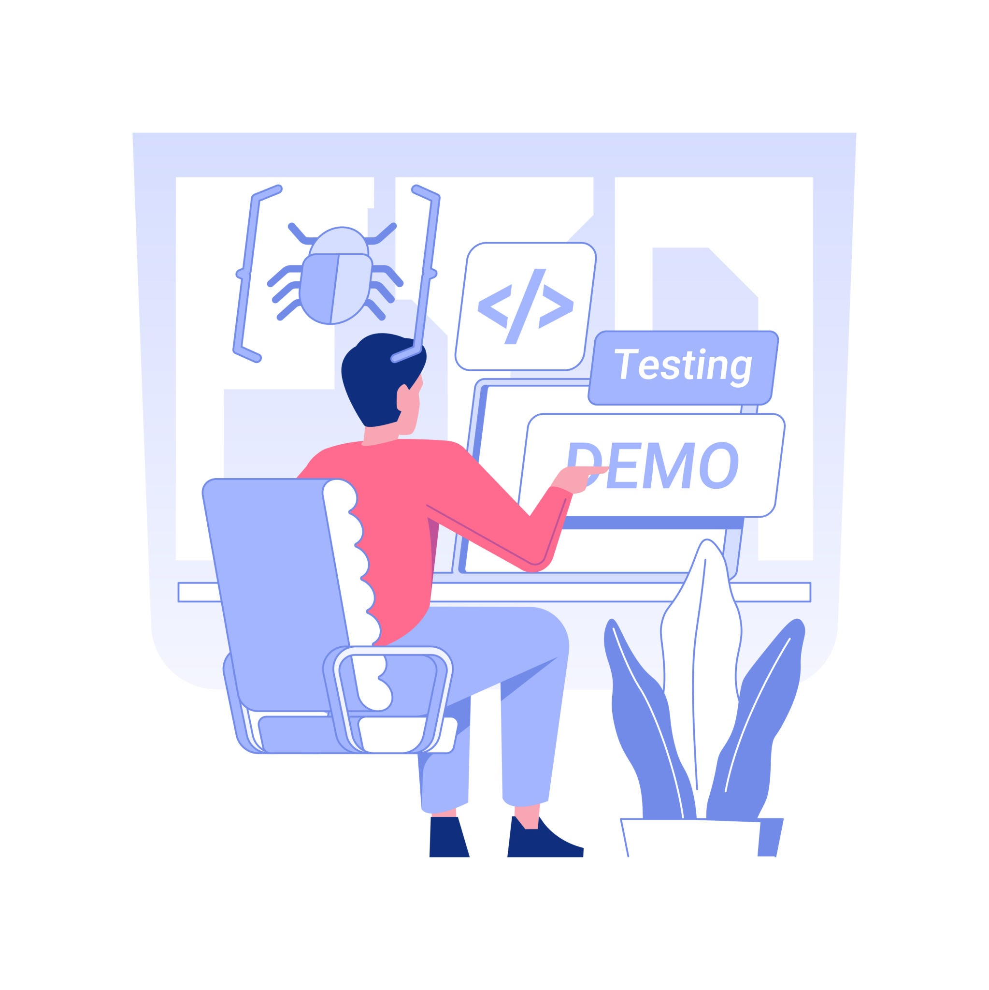
Prototype

Slide 5
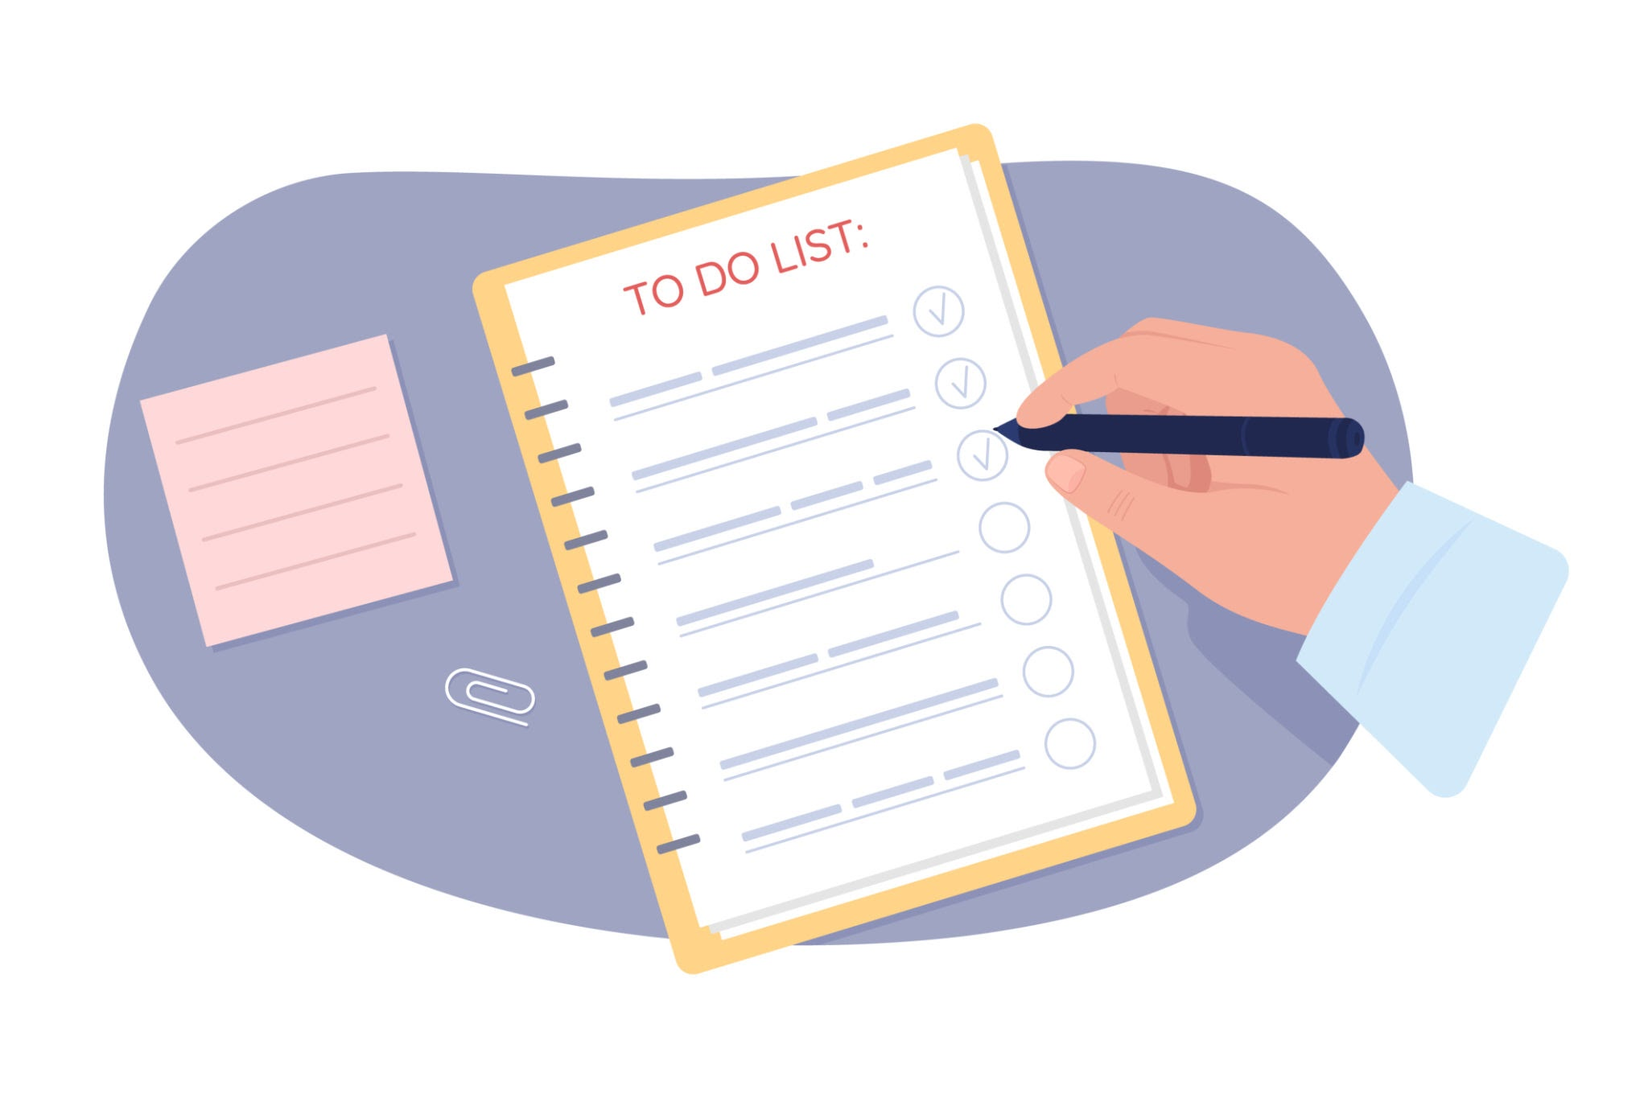
Functional Requirements
Upload audio files (e.g., MP3, WAV) from the user’s device
Separate audio into components — vocals, instrumentals, background layers
Adjust individual track levels through the chosen interface (sliders, knobs, etc.)
Provide real-time preview of adjustments before exporting
Save the setting for future use

Slide 6
UX Requirements
The interface should be simple and intuitive for users with little or no audio-editing experience.
Provide immediate visual and auditory feedback when adjustments are made.
Enable smooth, low-latency interaction for real-time control.
Maintain a clean, uncluttered layout that highlights main controls.
Support users with different hearing or visual needs through clear visuals and contrast options.

Slide 7
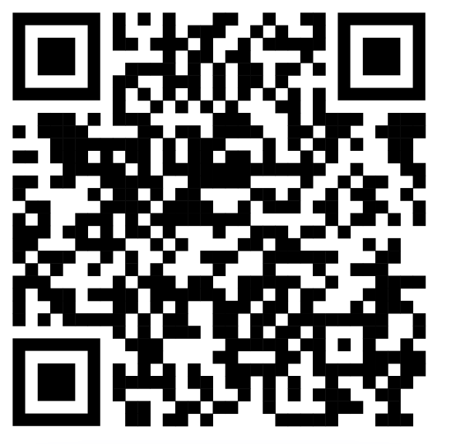
Prototype link
https://muse-ai594.web.app/

Slide 8
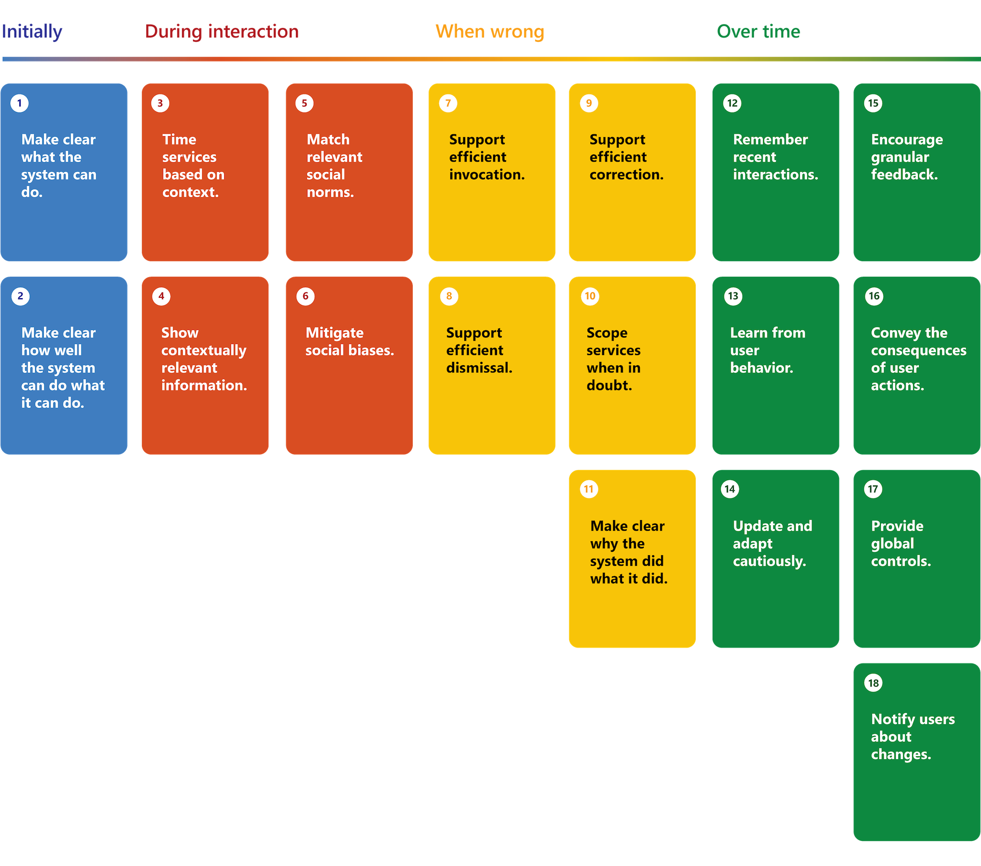

HAX Guidelines

Slide 9
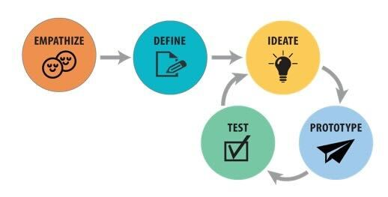
HAX Guidelines

Slide 10
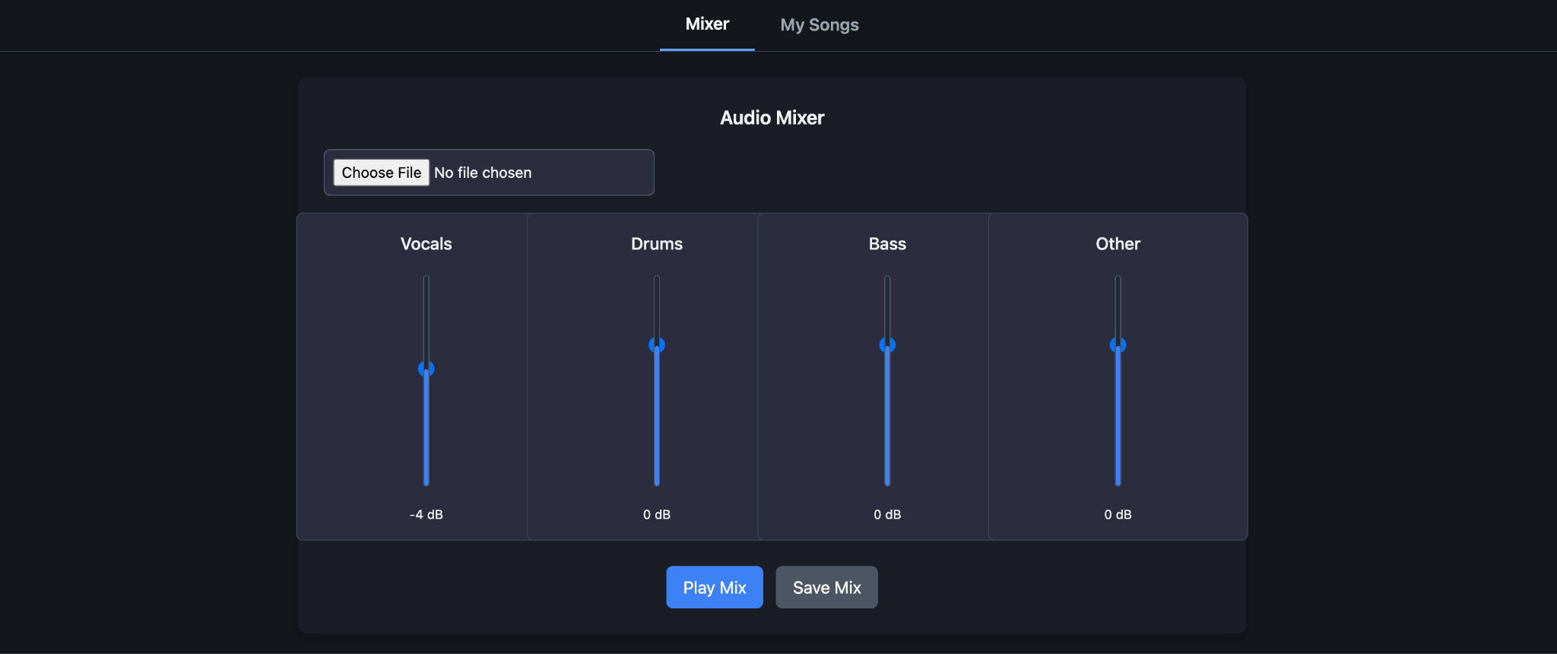
Heuristic Evaluation
Guideline 1: Make clear what the system can do
No about section
No help/tutorial section
Insert description of the system, or short tutorial

Slide 11
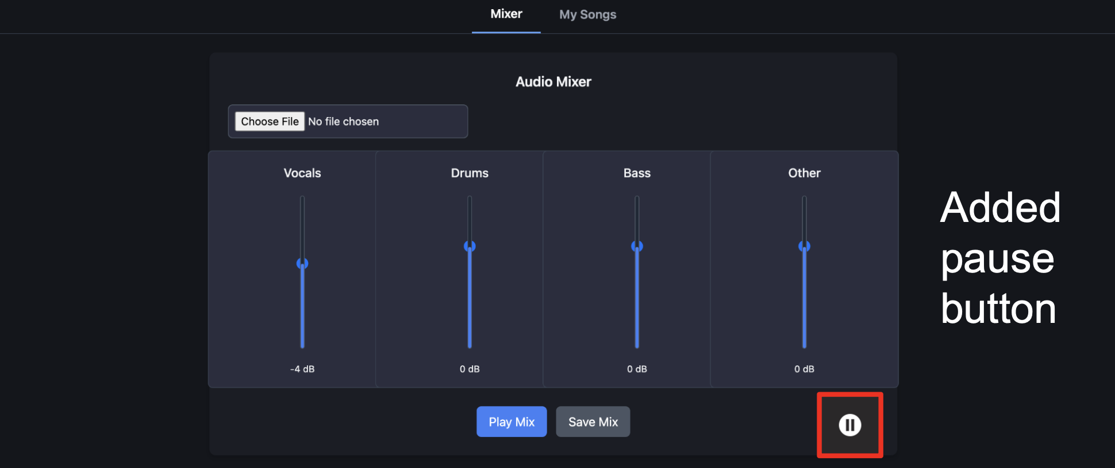
Heuristic Evaluation
Guideline 8: Support efficient dismissal
Add a play/pause button

Slide 12
Heuristic Evaluation
Guideline 10: Scope services when in doubt
Make it clear MUSE can make mistakes
  Warning or model description text
Disclaimer: MUSE can make mistakes

Slide 13
Heuristic Evaluation
Guideline 12: Remember recent interactions
Store user’s mixed songs / settings

Slide 14
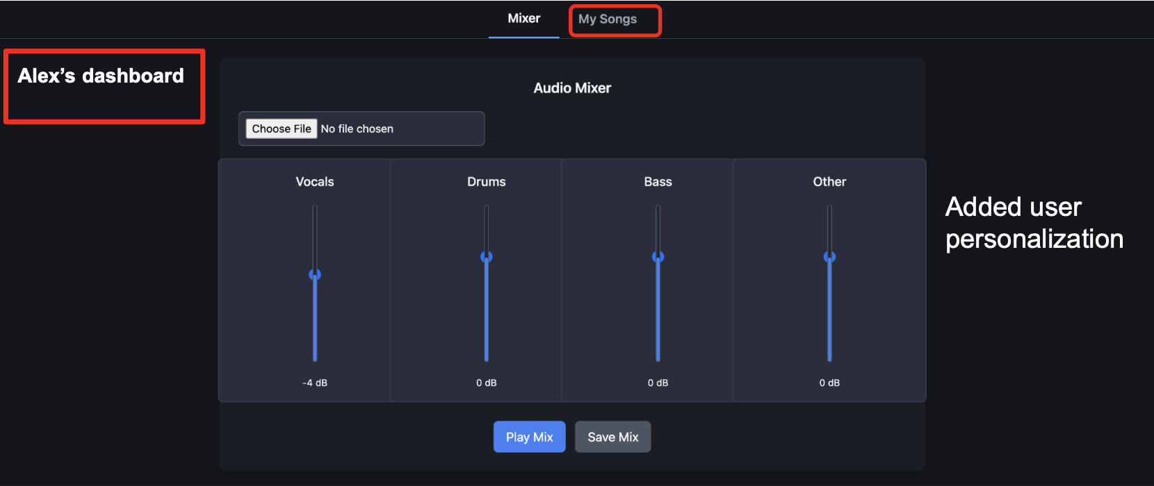
Heuristic Evaluation
Guideline 13: Learn from user behavior
Include UI for user-specific options

Slide 15
Heuristic Evaluation
Guideline 9: Support efficient correction
Guideline 15: Encourage granular feedback
A system for feedback
  UI-based feedback system
  Model-based feedback system
Please enter your detailed feedback here
👍 👎

Slide 16
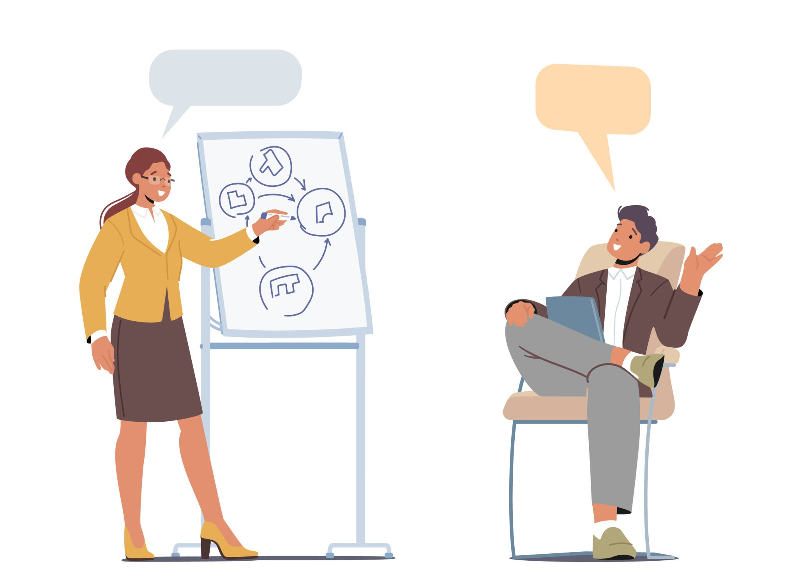

Other Planned Updates
Previously mentioned updates
Model integration
  Improved latency with the model
Light and dark themes
Incorporate more auditory feedback
Finalize audio channels
  Vocal, drums, guitar, bass, others?
User-specific recommendations?

